Slide 1
DevOps Engineer Assignment

Slide 2
Assignment description
A development team developing a billing application, one of the releases contain a change which will have huge impact on the application performance and the product owner want this release as fast as possible, in order to deliver this release it took around 3 working days after they finished the coding (exceeded the scheduled date by 3 days) in order to integrate the code, checking its quality, proceed in the testing phase and then deploy it.
You are the deployment geek who is responsible to deploy this application on the targeted environment and you didn’t like the fact that they spent 3 days to get their application ready to be deployed and you want to convince them to transform to the DevOps methodology

Slide 3
Requirements
1. What are the steps you are going to take to lead this transformation? a. Provide a presentation explaining the steps/milestones taking into consideration that the development team is not familiar with the DevOps methodology.
2. Imagine that you convinced them, they agreed to transform, and you have been asked to get the DevOps platform ready: a. Implement and configure secure Kubernetes cluster on AWS using infrastructure as a code.
b. Implement the needed DevOps tools to create CICD pipeline (Jenkins, SonarQube, Nexus, etc. ...) using ansible or any other configuration management tool on the created k8s cluster.
c. Implement a CICD pipeline for any application using the tools and the platform implemented from the previous steps this pipeline should be using groovy scripting Jenkins file.
Additional notes:
For the second requirement please provide the git repo with detailed readme file describing the steps and a presentation showing how you implemented the solution.

Slide 4
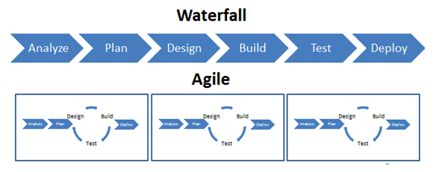
Waterfall vs Agile methodology

Slide 5
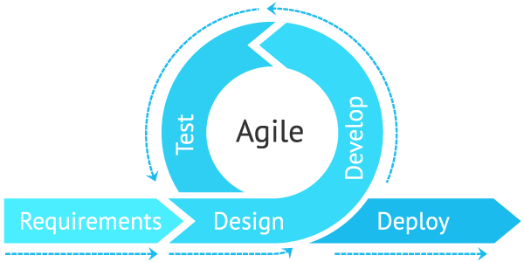
Sprint

Slide 6
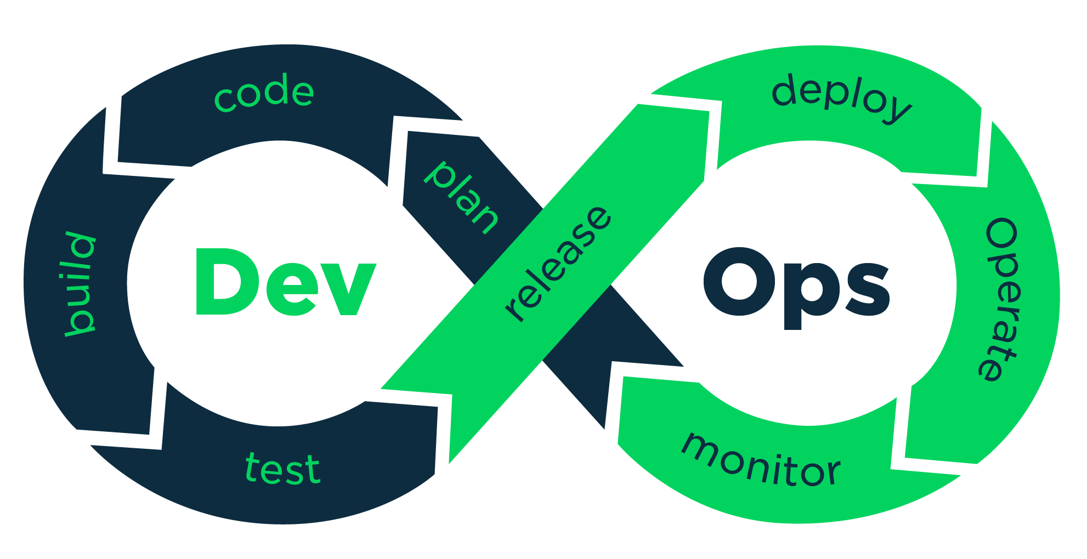
DevOps methodology

Slide 7
DevOps
So we will use DevOps methodology in order to decrease human intervention so will avoid mistakes
improve the quality and speed
We will integrate devops tools together
It aims to shorten the systems development life cycle and provide continuous delivery with high software quality

Slide 8
The solution
We will install terraform in our local machine
Create account in AWS and name it : terraformuser with full access Ec2 permissions
Install kubernetes cluster using the terraform
Will install ansible in our local machine, and the host will be the created cluster
Will let ansible deploy Jenkins, SonarQube, Nexus to the host (our Kubernetes Cluster)

Slide 9
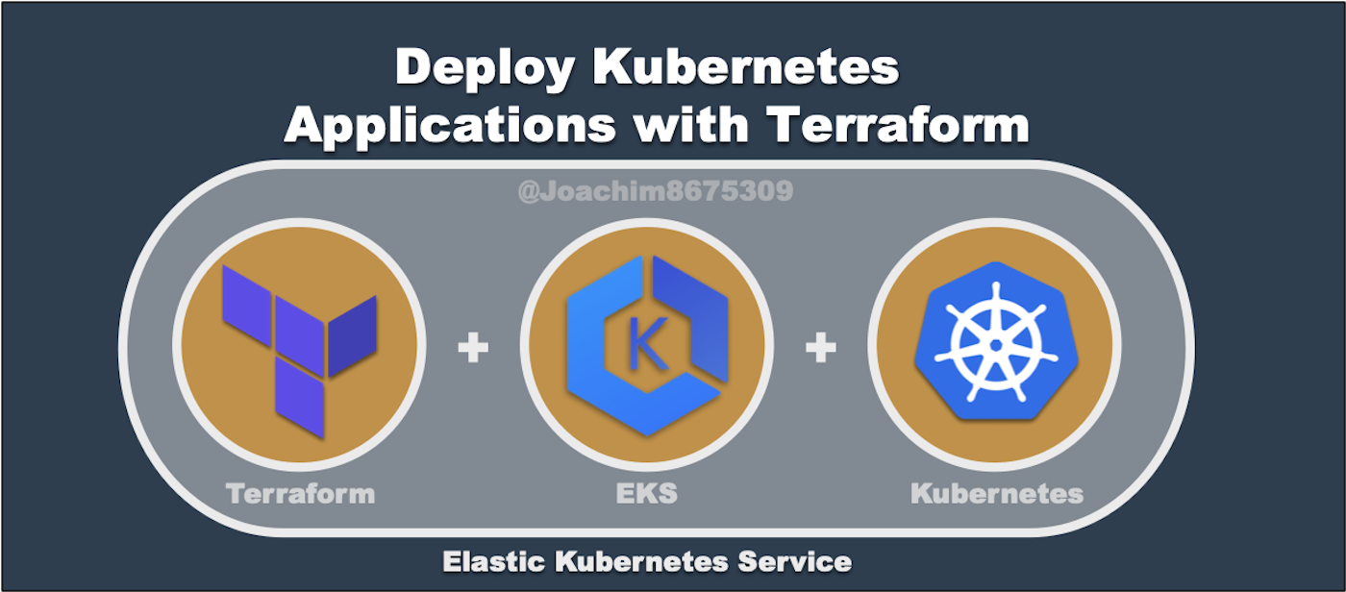
Kubernetes with IAAS

Slide 10
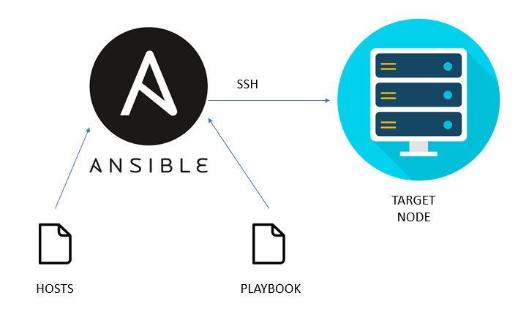

Slide 11
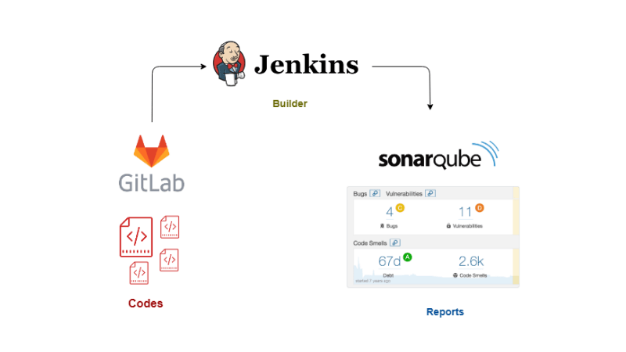

Slide 12
Before and After Jenkins
Before Jenkins | After Jenkins
The entire source code was built and then tested. Locating and fixing bugs in the event of build and test failure was difficult and time-consuming, which in turn slows the software delivery process. | Every commit made in the source code is built and tested. So, instead of checking the entire source code developers only need to focus on a particular commit. This leads to frequent new software releases.
Developers have to wait for test results | Developers know the test result of every commit made in the source code on the run.
The whole process is manual | You only need to commit changes to the source code and Jenkins will automate the rest of the process for you.

